Slide 1

Credit Risk
Daniel Garcia, Joe Soria,
Nicholas Shiery
STAT 473 – Dr. Liao

Slide 2
Agenda
Introduction
Questions
i
ii
Methods
Analysis
iii
iv
Conclusion
v

Slide 3

Introduction

Slide 4

Introduction
According to the Federal Reserve, “credit risk arises from the potential that a borrower or counterparty will fail to perform on an obligation.” For most banks, loans are the largest and most obvious source of credit risk. For our project we sought to answer four questions.

Slide 5


Questions

Slide 6

Our Questions
Question 1
Question 2
What attributes are significant in determining whether an applicant is a good or bad credit risk?
Which classification model is best? determined by (Accuracy, Specificity, AUC.)?
Question 3
Question 4
Which type of applicants should the bank accept?
Which type of applicants should the bank reject?
Credit Risk

Slide 7

The Data

Slide 8
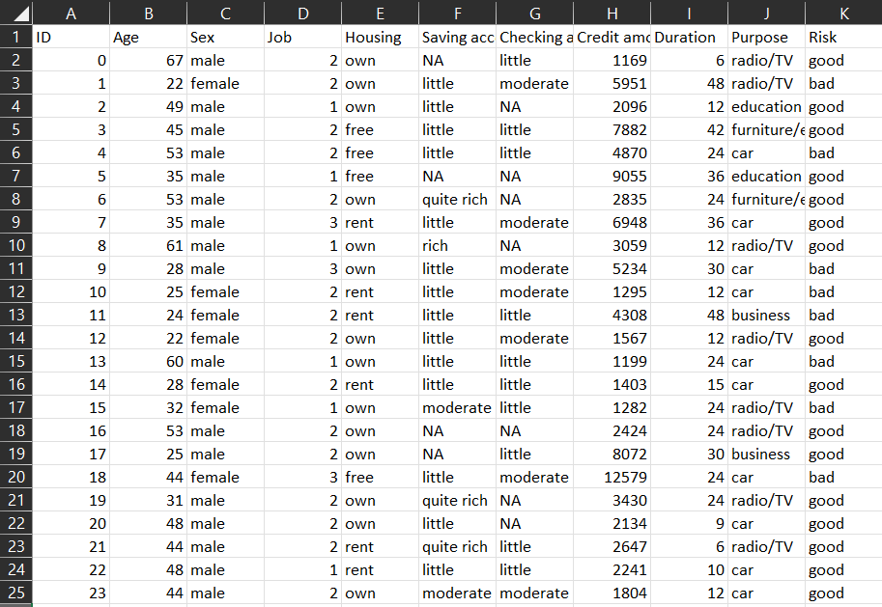
The Data
The data set was found on Kaggle.com, it was titled “Credit Risk”
It is a csv file containing 11 variables and 1000 observations

Slide 9
The Data
ID | Age | Sex | Job | Housing
Saving accounts | Checking account | Credit amount | Duration | Purpose
Risk
Above are the variables used in the analysis
Risk was our response variable

Slide 10
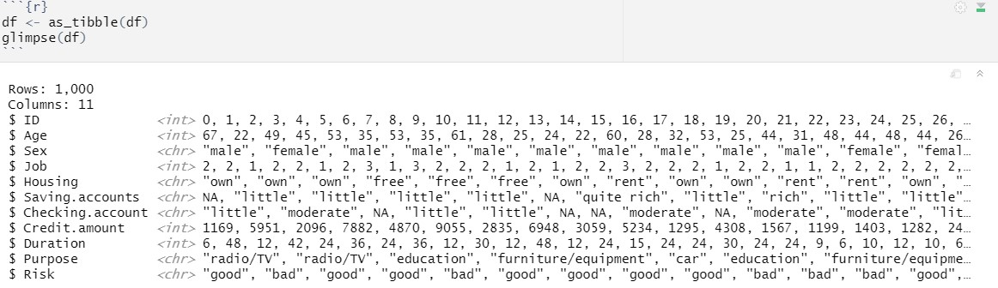
EDA
We can see there are numerous NA values

Slide 11
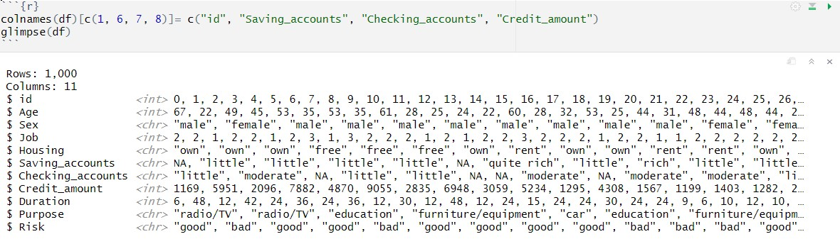
EDA
Cleaning the data we first change some of the column names

Slide 12
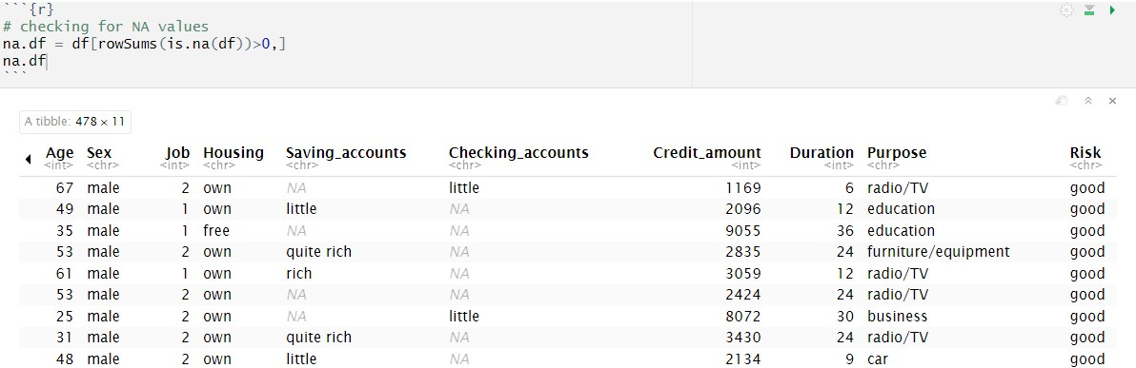
EDA
As we can see checking accounts and saving accounts have numerous NAs

Slide 13
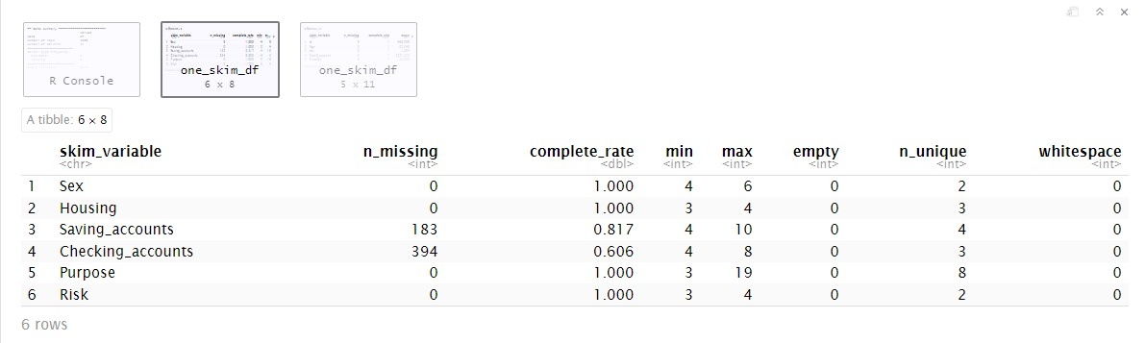
EDA
Skimming the data set we see…
Saving_accounts has 183 NAs and Checking_accounts has 394 NAs

Slide 14
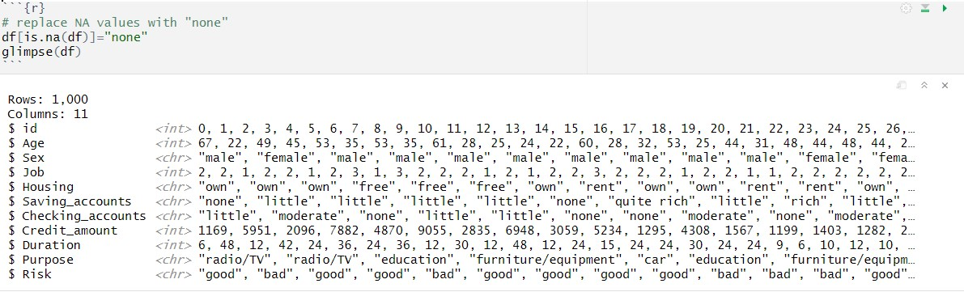
EDA
We replace the NAs with “none”

Slide 15
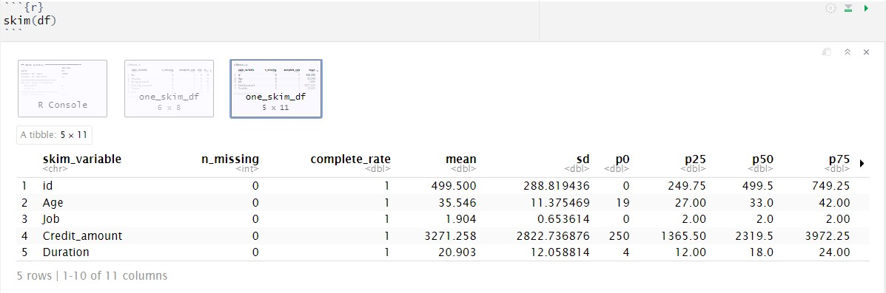
EDA
We see Age has a mean of 35.54 and a s.d. of 11.37
Credit_amount with a mean of 3271.25 and a s.d. of 2822.73
Duration has a mean of 20.9 and a s.d. of 12.05

Slide 16
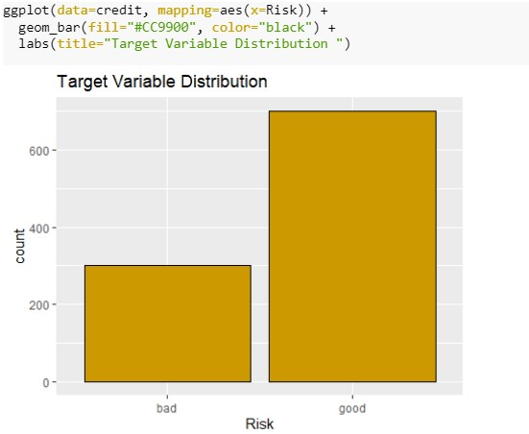
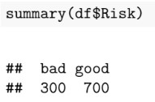
EDA
Here we see the Risk variable, our response variable, and the distribution of responses
Data set is unbalanced

Slide 17
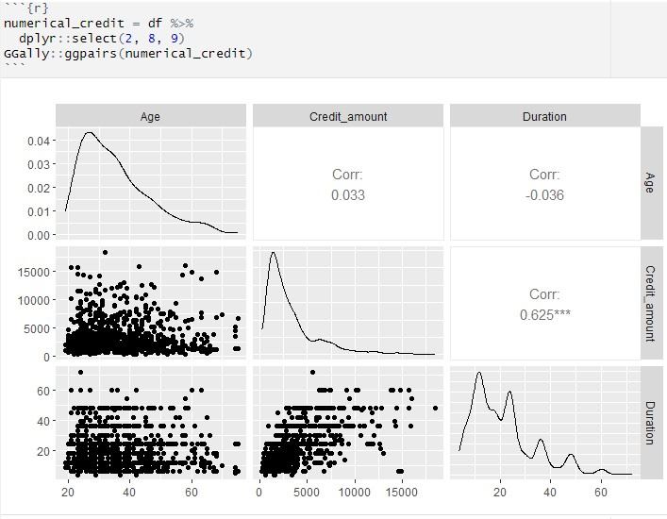
EDA
We see from the correlation matrix Duration and Credit_amount have the highest correlation

Slide 18
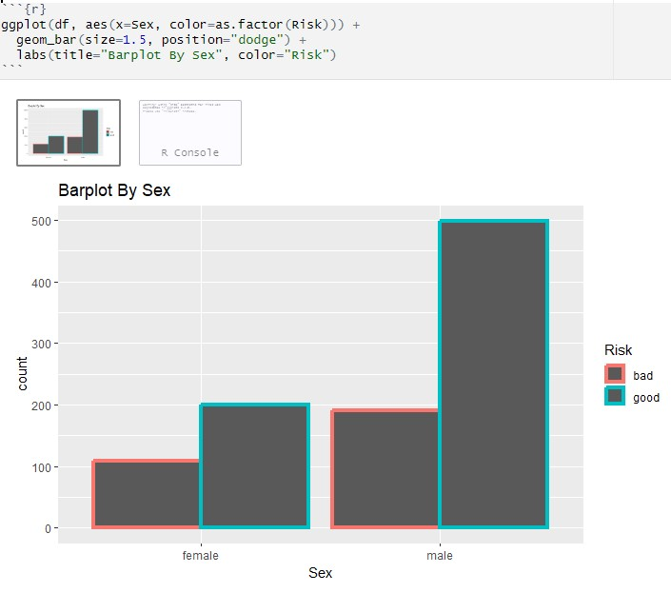
EDA
Constructing the barplot and grouping by sex reveals males with a greater good risk and higher bad risk than females

Slide 19
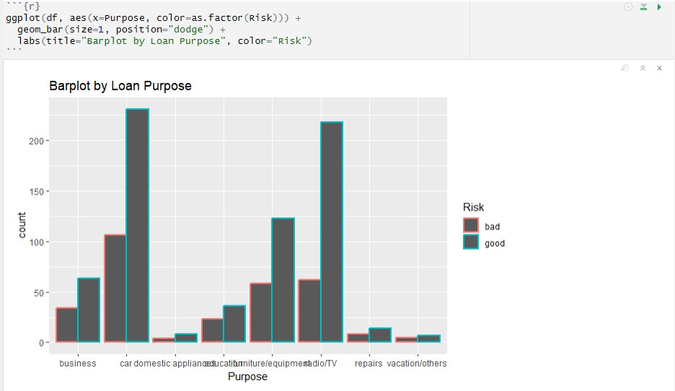
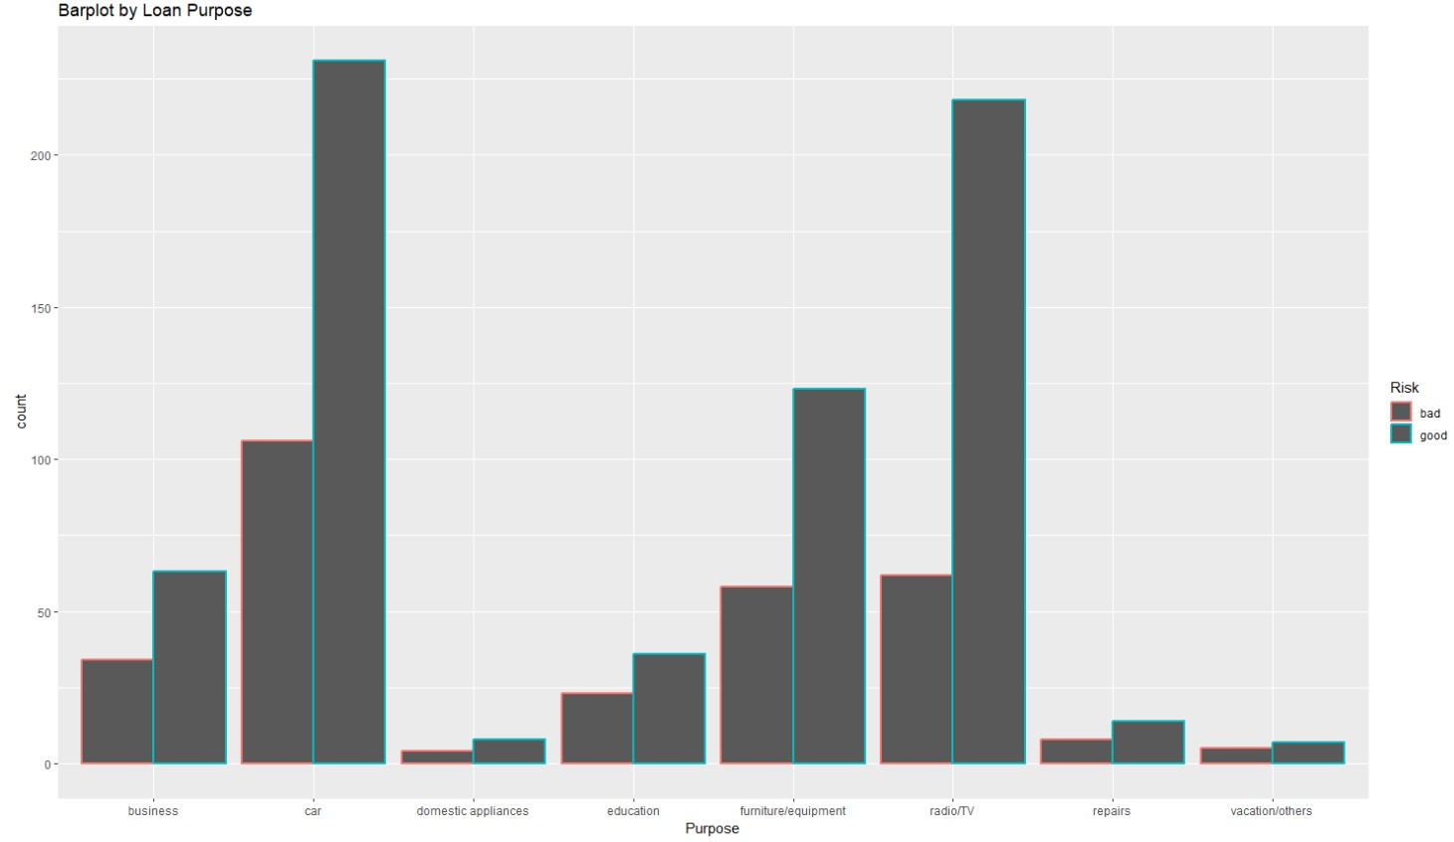
EDA
Radio/TV and Car make up a significant proportion of bank loans.
Car loans have the highest bad risk and highest good risk

Slide 20
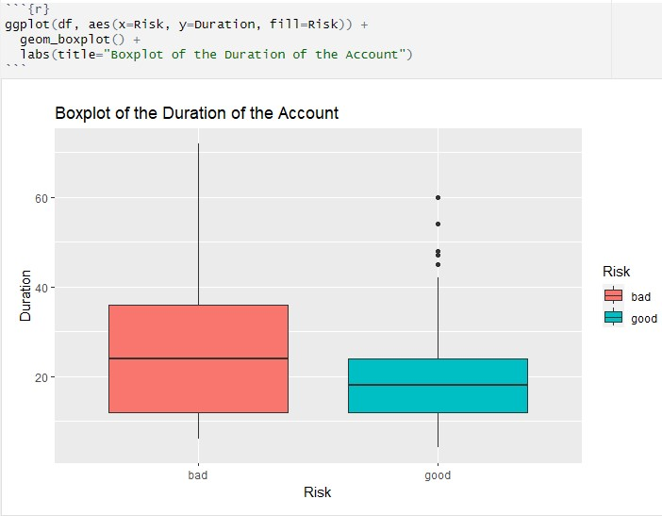
EDA
Median duration in bad risk has the highest median
Numerous outliers in good risk duration
Duration on the account influences the Risk associated with the account.
Short term loans are typically better

Slide 21
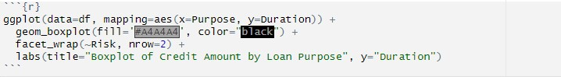
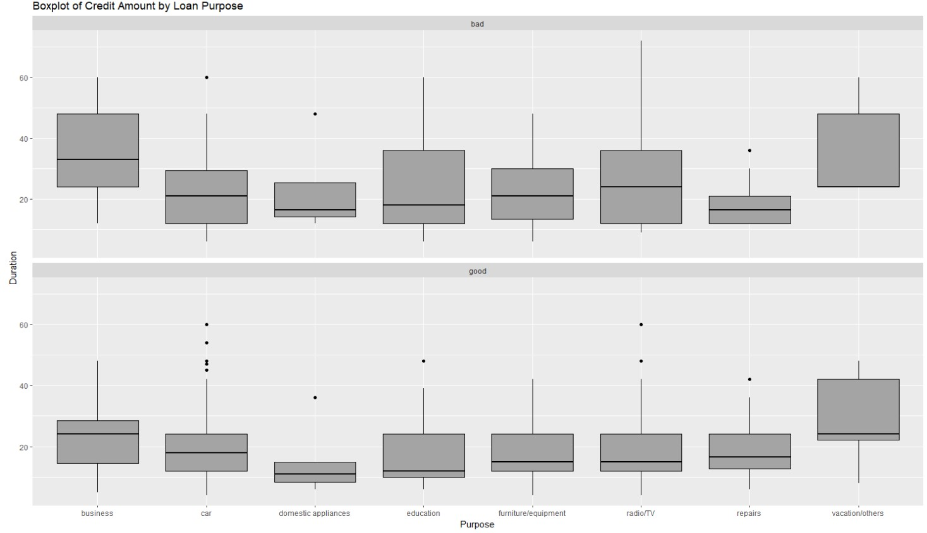
EDA
Longer duration accounts are typically requested for vacation/other purposes and business purposes
Car loans have numerous outliers

Slide 22

Methods

Slide 23
Type of Problem
Response Variable 'Risk' is Good or Bad.
Classification
Prediction

Slide 24
Models
Logistic Regression
LDA
Bagging
Random Forest

Slide 25
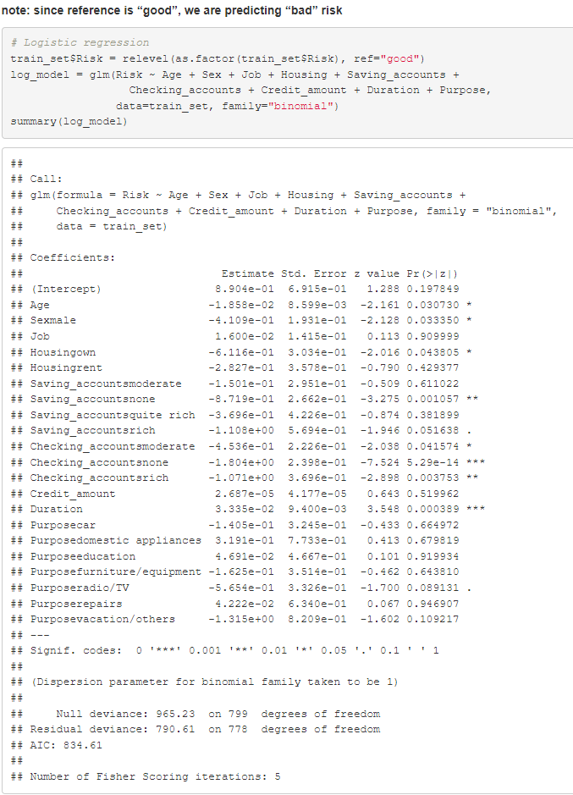
Logistic Regression Model
α = 0.05
Significant predictors: Age, Sex, Housing, Saving account, Checking account, and Duration

Slide 26
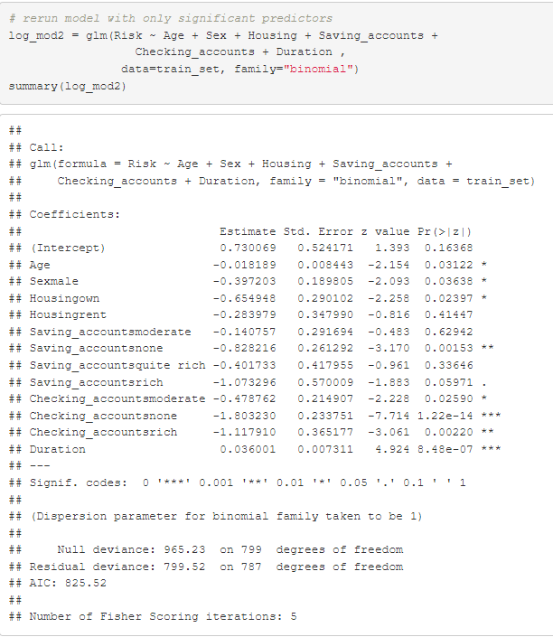
Logistic Regression Model

Slide 27
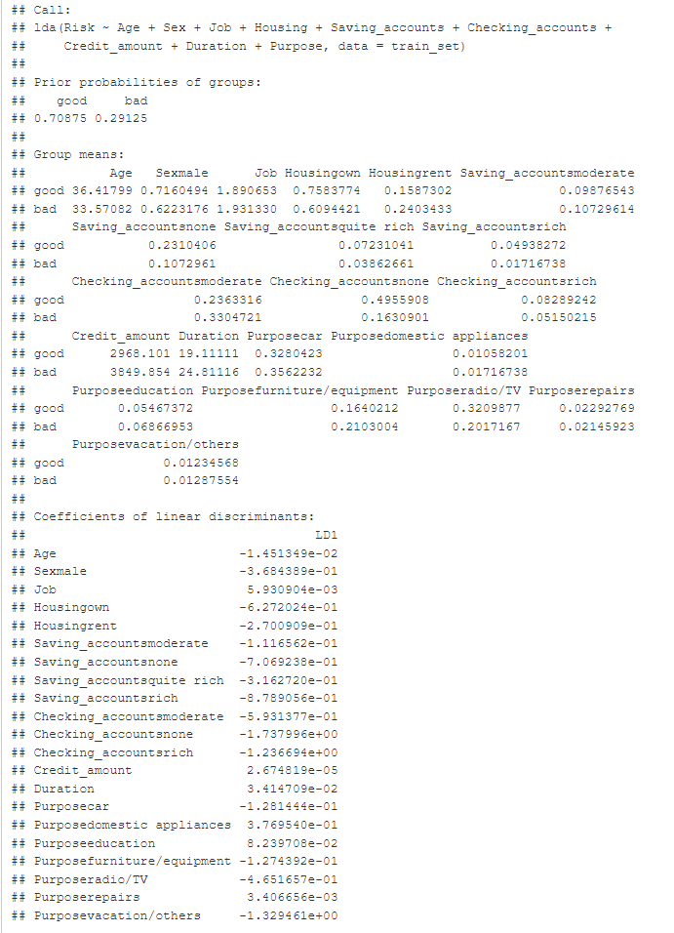
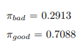
LDA Model
Prior probabilities

Slide 28
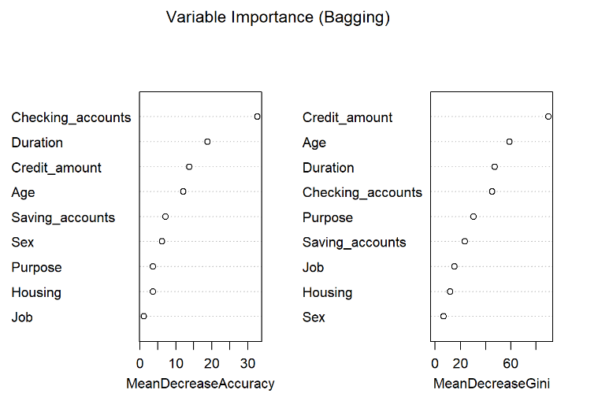
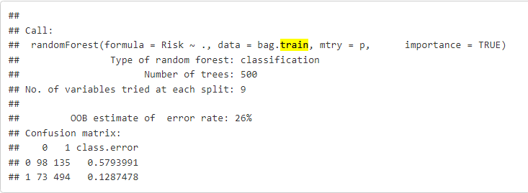
Bagging Model

Slide 29
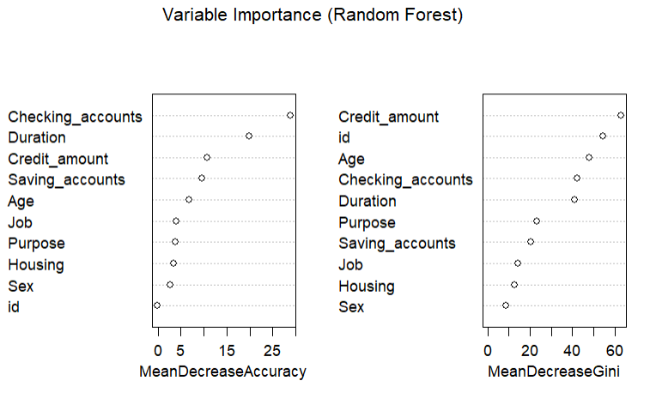
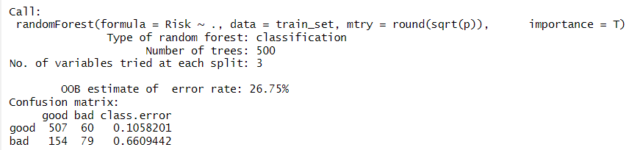
Random Forest Model

Slide 30
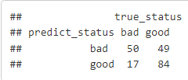
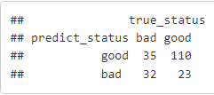
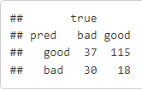
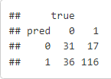
Confusion Matrices
Logistic Regression
LDA
Random Forest
Bagging

Slide 31
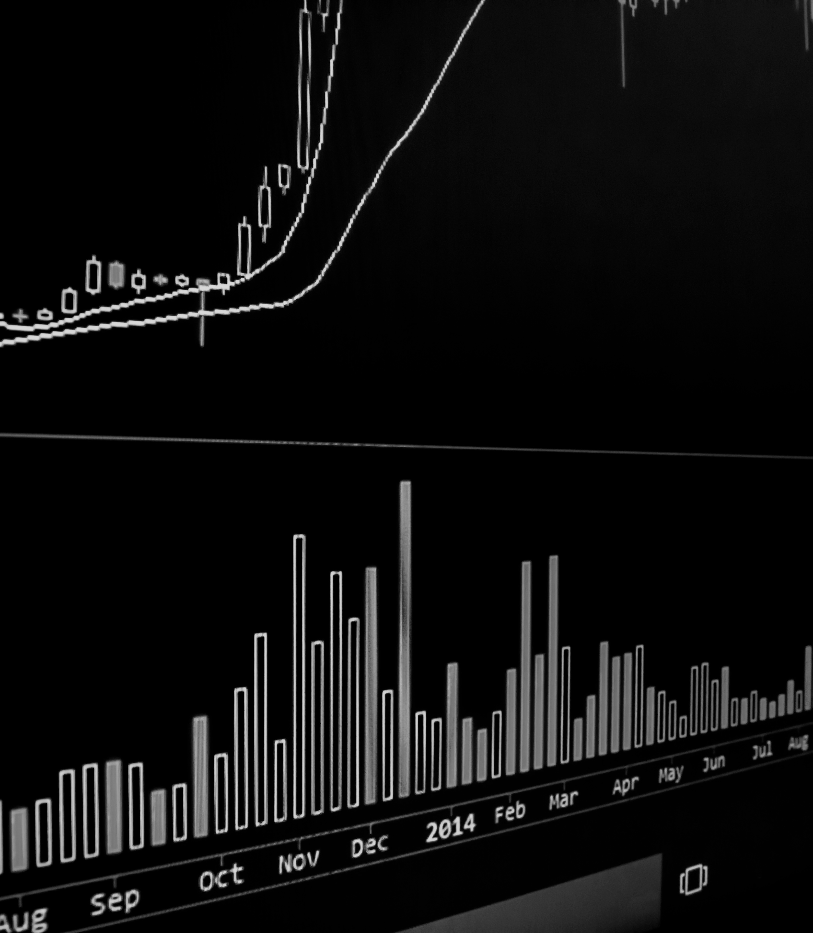
Analysis

Slide 32
Choosing the best model
Accuracy
Specificity
Sensitivity
False Negative Rate
False Positive Rate

Slide 33

Choosing the Best Model
Accuracy
False Positive Rate
Accuracy is the best model for maximizing overall profit.
Accuracy allows us to correctly identify the maximal good risk clients while minimizing the bad risk clients.
False positive rate (FPR) is the best model for minimizing risk.
By minimizing FPR, we prevent loss by declining loans to bad risk clients.

Slide 34
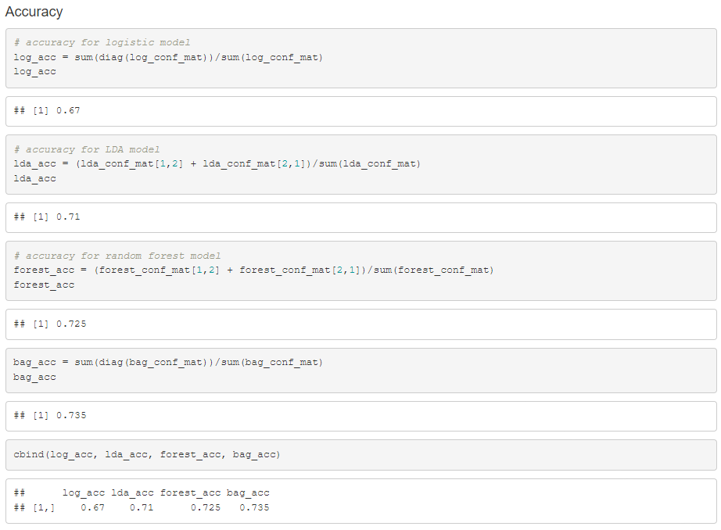
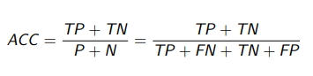


Accuracy
Our bagging model has the best accuracy, followed by the random forest model and the LDA model

Slide 35
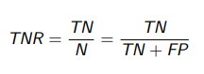
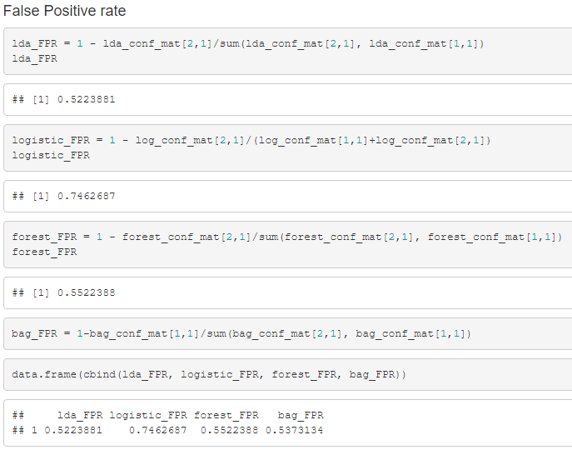


False Positive Rate
Specificity =
LDA model has the best false positive rate, followed by the bagging model
FPR = 1 - specificity

Slide 36

Shortfalls
Accuracy
False Positive Rate
Accuracy will lead to accepting more bad risk clients than we would like to
False Positive Rate will lead to rejecting more good risk clients than we would like to.

Slide 37

Summary

Slide 38
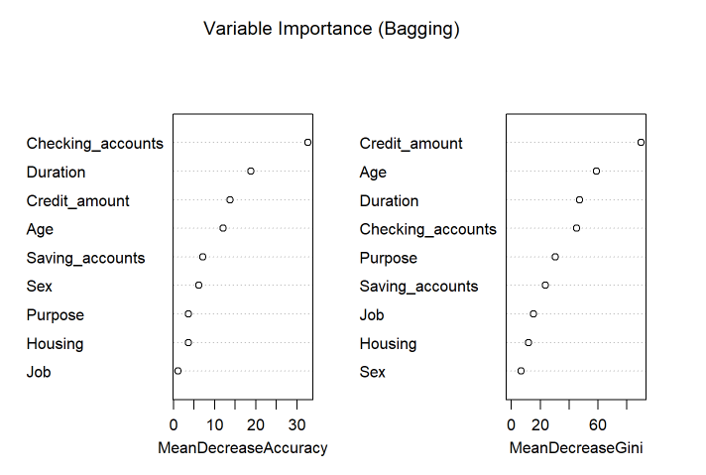

Question 1: What attributes are most significant in determining whether an applicant is a good or bad credit risk?
Based off our Logistic regression model, the significant predictors include: Age, Sex, Housing, Savings account, Checkings account, and Duration of account.
The four most important variables, according to the bagging model, are: Age, Credit amount, Duration, and Checkings account.

Slide 39
Question 2: Which classification model is best?
Depending on what our bank wants to prioritize, the best model is judged by accuracy or false positive rate.
For profit optimization, the bagging model is best since the accuracy is the highest.
For minimizing loss, the LDA model is the best since the false positive rate is the lowest.
Overall, we think the bagging model is best given the high accuracy rate and relatively similar FPR with the other models.

Slide 40
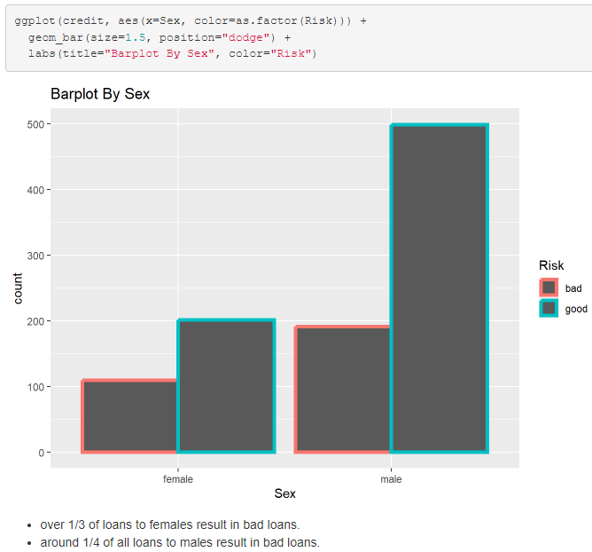
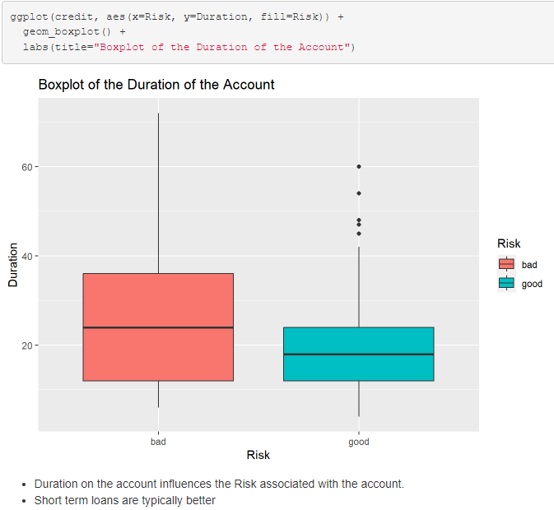
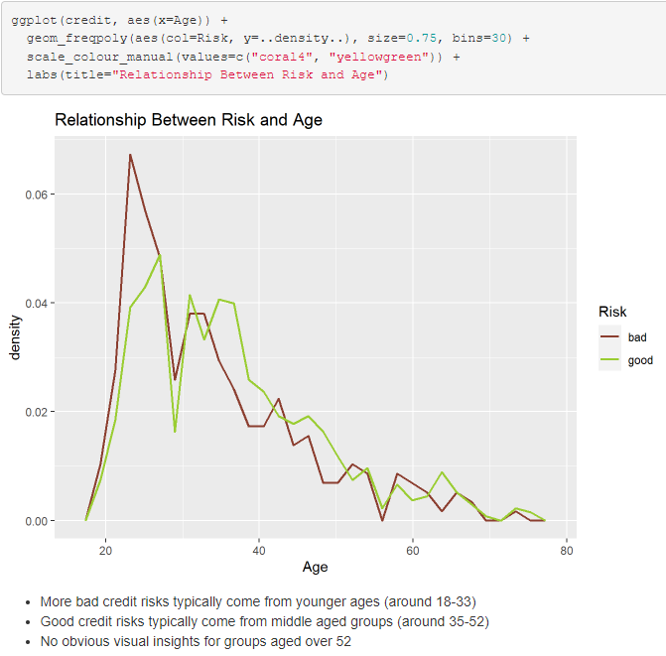
Question 3: Which type of applicant should the bank accept?
Our ideal loan candidate will be a male in the age range of 33-52, for radio/tv or car purpose, with a short term duration on the account.
We see from the bar plot that the proportion of good loans to bad loans for males is much smaller than females.
Box plot shows that bad loans are more correlated with longer duration loans
Frequency plot shows that good loans generally supersede the amount of bad loans at about age 33-52.

Slide 41
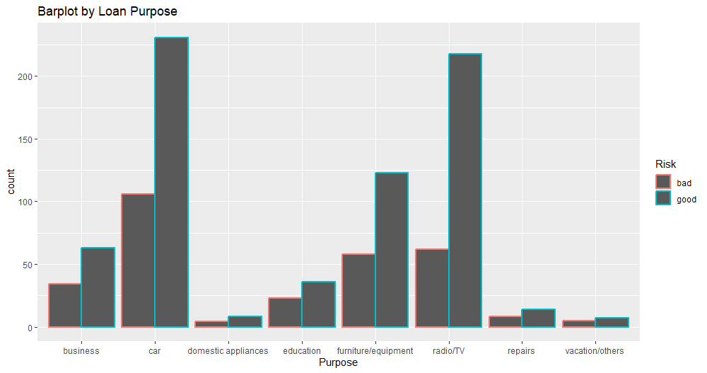

Question 4: Which type of applicants should the bank reject?
Generally, we want to stay away from loan candidates that are 33 years old or younger who want to take a loan out for vacation/other, business, repairs, or education purposes.
The frequency plot shows that most bad loans come from those who are younger in age.
The bar plot shows the proportion of good loans vs bad loans by the loan purpose. If the proportion of bad loans to good loans for a specific purpose is high, then we want to stay away from offering loans for those purposes.

Slide 42




Questions?

